Slide 1
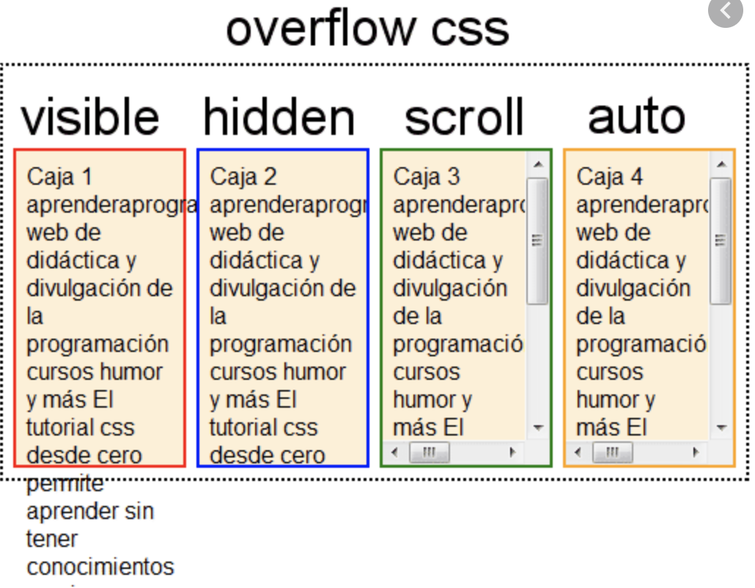
Overflow
The overflow property specifies what should happen if content overflows an element's box. Values: visible, hidden, scroll, auto
https://developer.mozilla.org/en-US/docs/Web/CSS/overflow

Slide 2
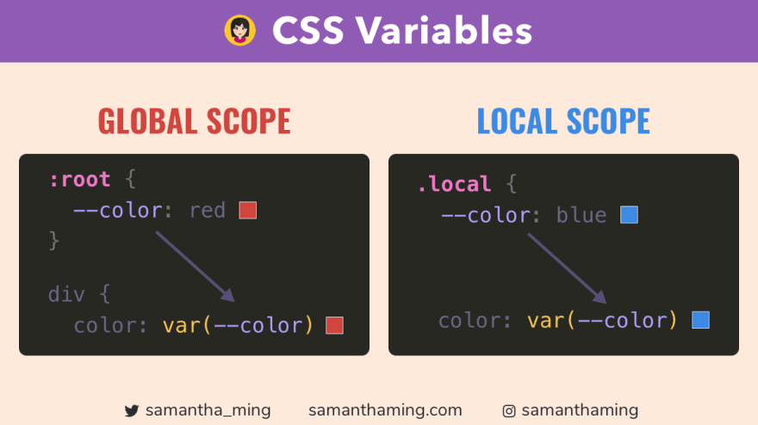
:root
:root is a pseudo-class that matches the document's root element.
https://developer.mozilla.org/en-US/docs/Web/CSS/:root

Slide 3
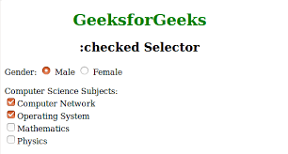
selector:checked
The :checked pseudo-class matches every checked input element.
https://developer.mozilla.org/en-US/docs/Web/CSS/:checked

Slide 4
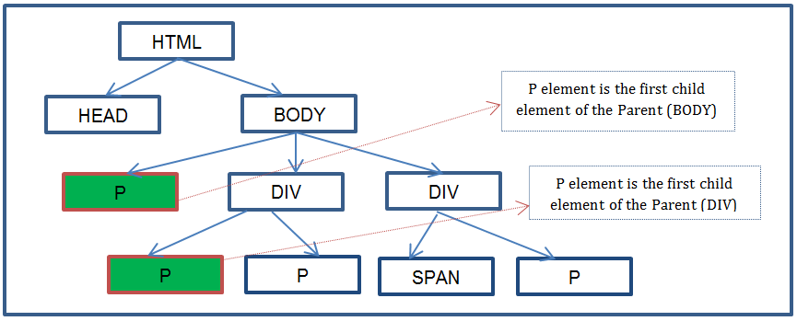
selector:first-child
The :first-child pseudo-class matches the first child element of its parent.
https://developer.mozilla.org/en-US/docs/Web/CSS/:first-child

Slide 5
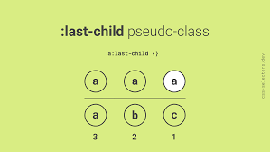
selector:last-child
The :last-child pseudo-class matches the last child element of its parent.
https://developer.mozilla.org/en-US/docs/Web/CSS/:last-child

Slide 6
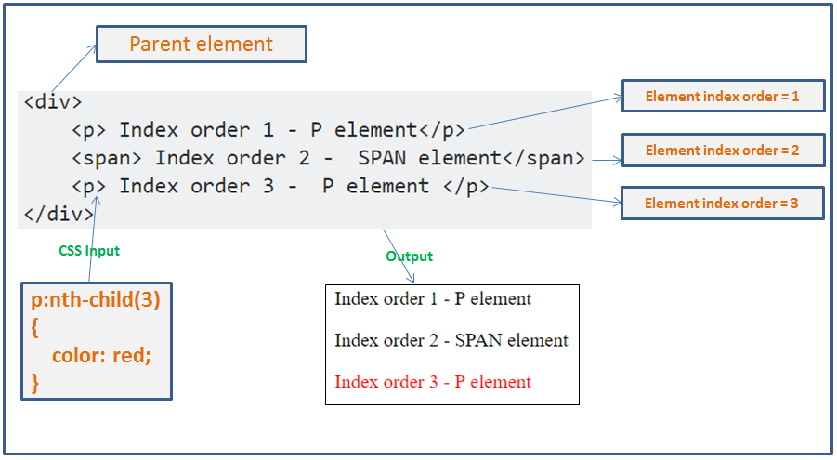
selector:nth-child(n)
The :nth-child(n) pseudo-class matches elements based on their position in a group of siblings.
https://developer.mozilla.org/en-US/docs/Web/CSS/:nth-child

Slide 7

selector:not(selector)
The :not(selector) pseudo-class matches every element that is not represented by the selector.
https://developer.mozilla.org/en-US/docs/Web/CSS/:not

Slide 8
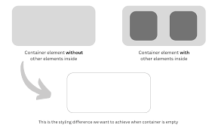
selector:empty
The :empty pseudo-class matches every element that has no children.
https://developer.mozilla.org/en-US/docs/Web/CSS/:empty

Slide 9
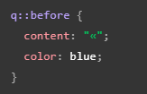

::before
The ::before pseudo-element inserts content before an element's content.
https://developer.mozilla.org/en-US/docs/Web/CSS/::before

Slide 10
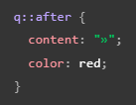

::after
The ::after pseudo-element inserts content after an element's content.
https://developer.mozilla.org/en-US/docs/Web/CSS/::after

Slide 11
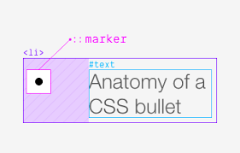
::marker
The ::marker pseudo-element selects the marker box of a list item.
https://developer.mozilla.org/en-US/docs/Web/CSS/::marker

Slide 12
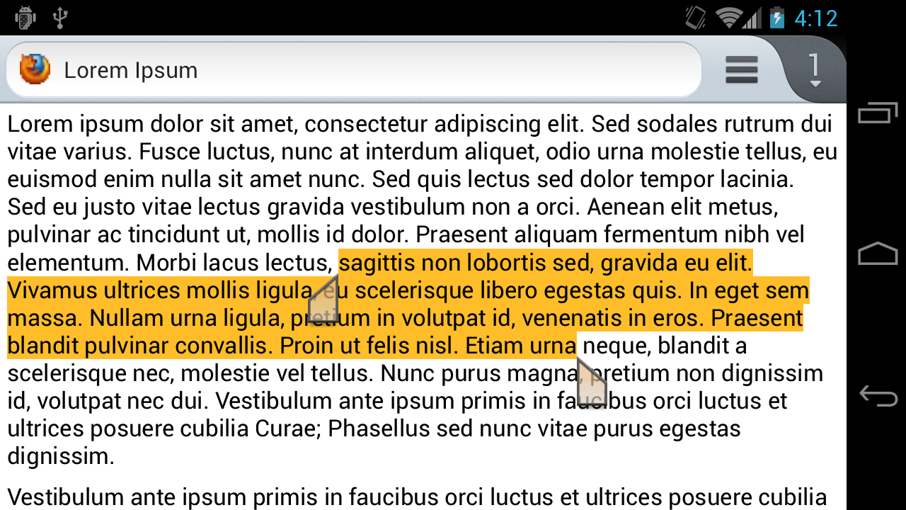
::selection
The ::selection pseudo-element applies styles to the portion of a document that has been highlighted by the user.
https://developer.mozilla.org/en-US/docs/Web/CSS/::selection

Slide 13

Opacity
The opacity property sets the opacity level for an element.
Value: Any number strictly between 0 and 1.
https://developer.mozilla.org/en-US/docs/Web/CSS/opacity

Slide 14
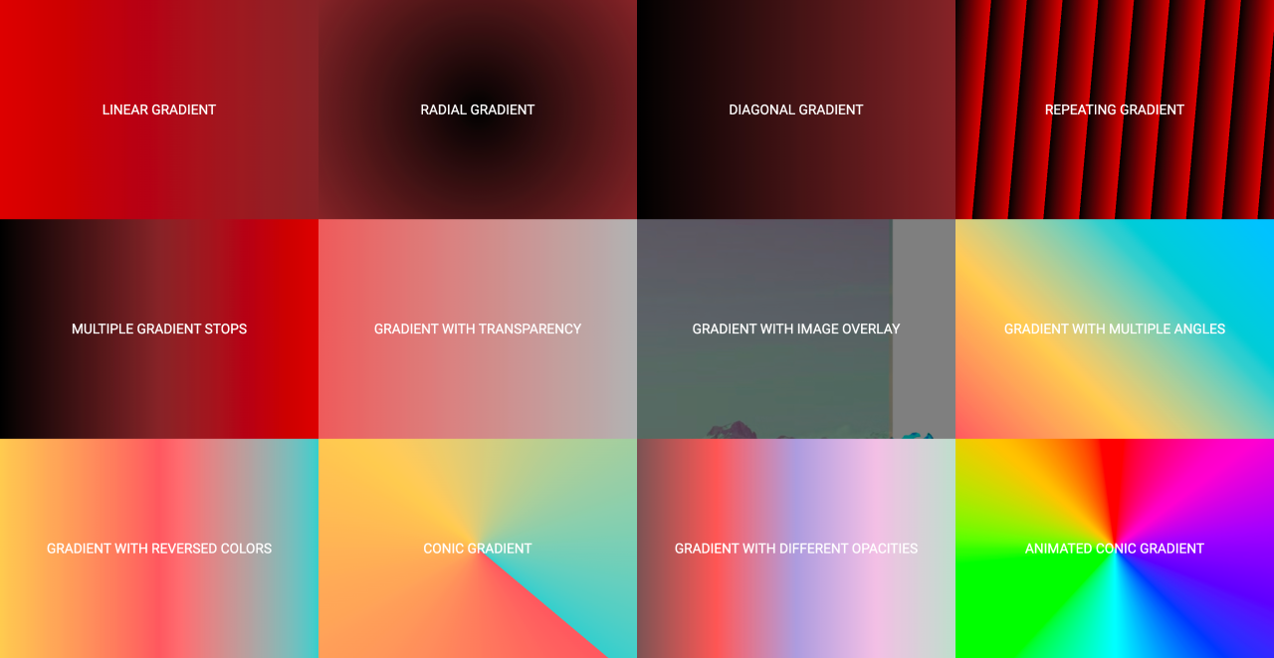
Gradient
background: linear-gradient(angle, color, ..., color);Creates a linear gradient as the background image.
https://developer.mozilla.org/en-US/docs/Web/CSS/gradient/linear-gradient

Slide 15
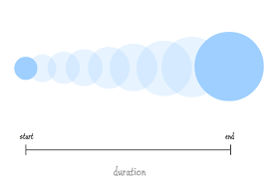
Transition
Defines the transition between two states of an element.Example:
{ transition: margin-right 4s ease-in-out 200ms;}
https://developer.mozilla.org/en-US/docs/Web/CSS/transition

Slide 16

Transform
The transform CSS property lets you rotate, scale, skew, or translate an element. It modifies the coordinate space of the CSS
https://developer.mozilla.org/en-US/docs/Web/CSS/transform

Slide 17
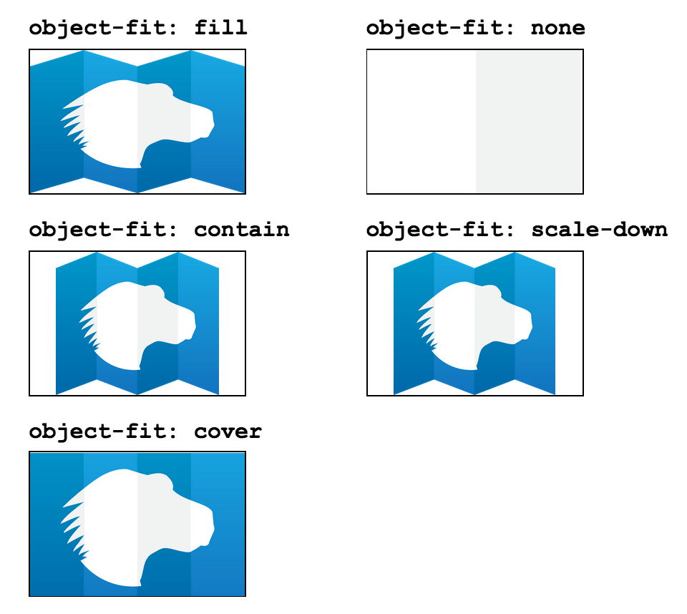
Object-fit
Defines how the content of a replaced element should be resized to fit its container.
Values: fill, contain, cover, none, scale-down
https://developer.mozilla.org/en-US/docs/Web/CSS/object-fit

Slide 18
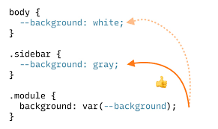
Custom Properties
CSS variables allow you to store values that you want to reuse throughout a document.
Declare: --first-color: #16f;
Use: background-color: var(--first-color);
https://developer.mozilla.org/en-US/docs/Web/CSS/Using_CSS_custom_properties

Slide 19

Media Queries
Media queries allow the application of CSS based on the conditions of the device.Example: @media screen and (min-width: 600px) { .element { /* styles */ } }
https://developer.mozilla.org/en-US/docs/Web/CSS/CSS_media_queries/Using_media_queries

Slide 20

Animation
Animations allow you to animate the values of CSS properties
https://developer.mozilla.org/en-US/docs/Web/CSS/CSS_animations/Using_CSS_animations

